Slide 1

Direct Marketing Campaign Optimization for a Retail Bank
Term Deposit Subscription Prediction using Machine Learning
Name – Anshadha Upasani

Slide 2
Problem statement :
The bank has conducted several direct marketing campaigns via phone calls to promote term deposit products. The challenge is to predict whether a customer will subscribe to a term deposit based on past campaign and customer data.
Objectives:
1) Develop a classification model that predicts customer subscription to term deposits.
2) Utilize demographic, financial, and campaign interaction data.
3) Enhance:
Targeted marketing
Campaign success rate
Cost-efficiency of outreach

Slide 3
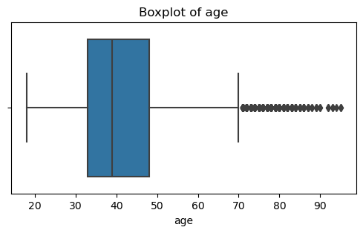
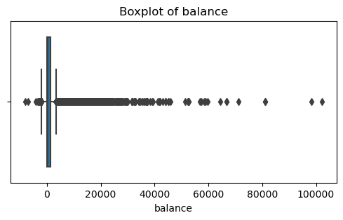
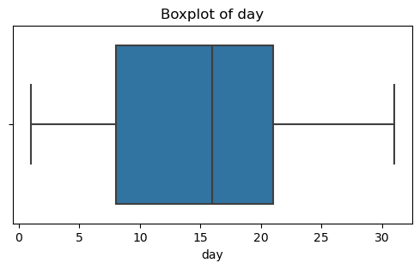
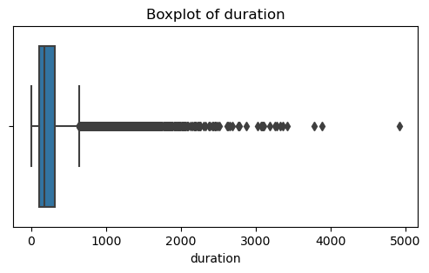
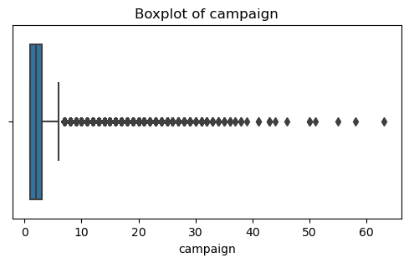
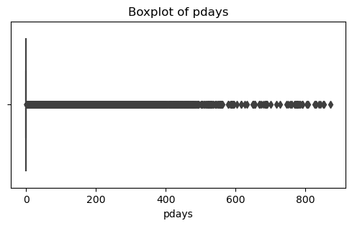
Dataset Overview
Total records: ~41,000
Features: 16 input features + 1 targe
Types of attributes:
Demographic: Age, Job, Marital, Education
Financial: Balance, Loan, Housing
Campaign: Contact method, Duration, Previous outcome

Slide 4
Data Preprocessing
Null values check: None
Dropping unwanted values
Checking Missing values
Encoding: Label Encoding for y, One-Hot Encoding for categorical variables
Defining the outliners
Treating outliners
Correlation analysis to identify important features
Scaling: StandardScaler for numerical features
Train-Test Split: 70% train, 30% test
Algorithms used:
Logistic Regression
Decision Tree - Random
XGBoost.
Random Forest-
Model Building

Slide 5
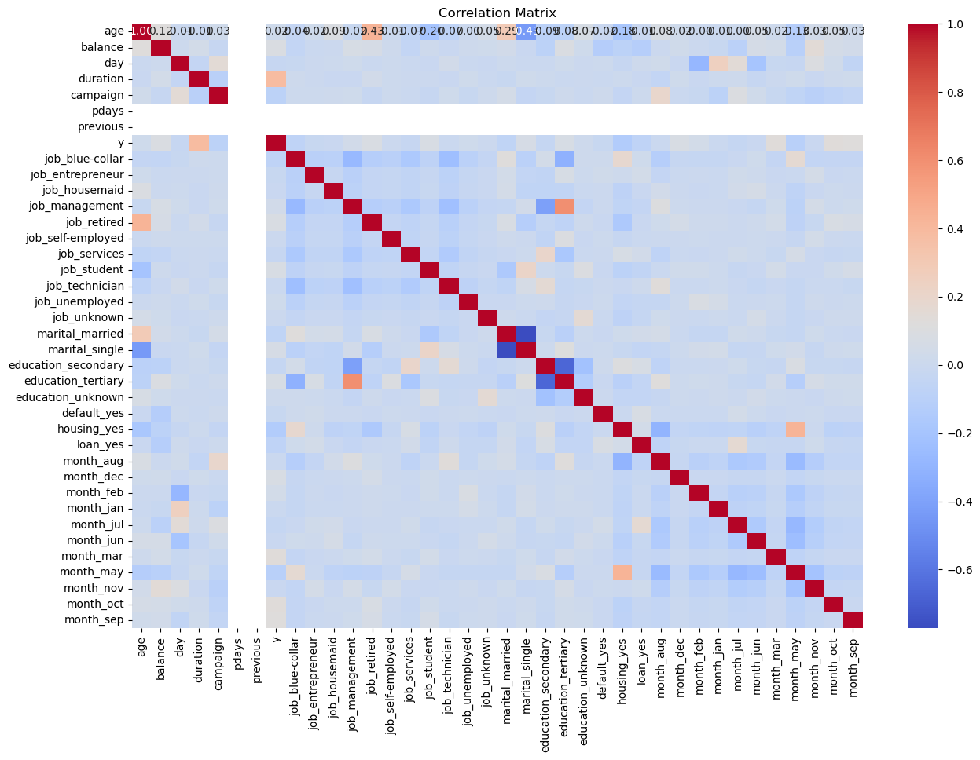
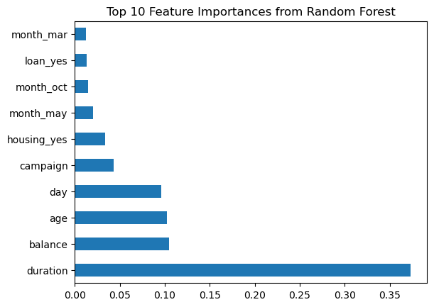
Important features:
Age – Age of the client
Balance – Account balance of the client.
Pdays – Days since the client was last contacted (-1 means never).
Campaign – Number of contacts performed during campaign.
Duration – Duration od the last contact in seconds.
Day – Last contact day of the month.

Slide 6
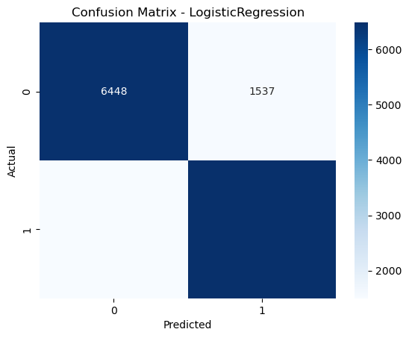
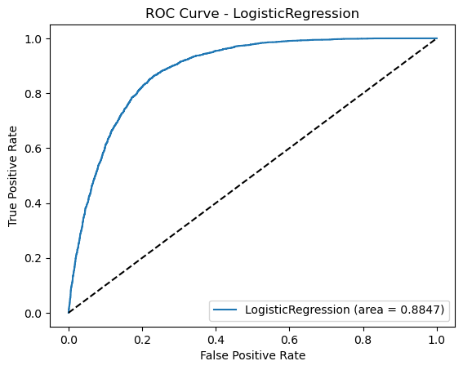
Linear Regression
– Because the data is in linear relation with the target
precision | recall | f1-score | support
0 - 0.81 | 0.81 | 0.81 | 7985
1 - 0.81 | 0.81 | 0.81 | 7984
accuracy
0.81
Precision (0 & 1): 81% → Out of all predicted positives, 81% were correct.
Recall (0 & 1): 81% → The model correctly identified 81% of actual positives.
F1-Score (0 & 1): 81% → Balance between precision and recall is strong.
Accuracy: 81% → The model made correct predictions for 81% of total cases (15,969 samples).

Slide 7
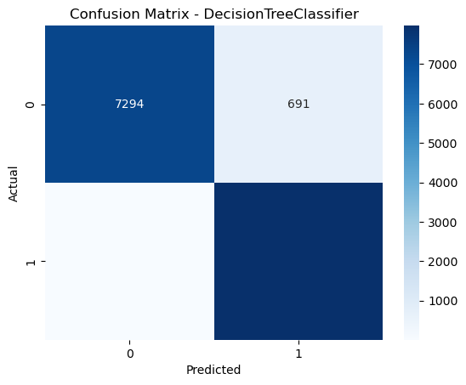
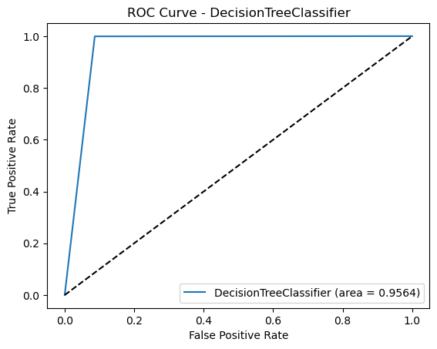
Decision tree:
for non-linear patterns , is easy to visualize and explain.
precision | recall | f1-score | support
0 - 1.00 | 0.91 | 0.95 | 7985
1 - 0.92 | 1.00 | 0.96 | 7984
accuracy
0.96
Accuracy = 96% → Out of 100 people, the model correctly predicted 96.
Precision
For class 0 (didn’t subscribe): 100% → All predicted "No" were actually "No".
For class 1 (subscribed): 92% → Most predicted "Yes" were correct.
Recall
For class 0: 91% → Caught 91 out of every 100 real “No” cases.
For class 1: 100% → Caught all the real “Yes” cases.
F1-Score
High for both classes (95% & 96%) → Shows the model is balanced and reliable.

Slide 8

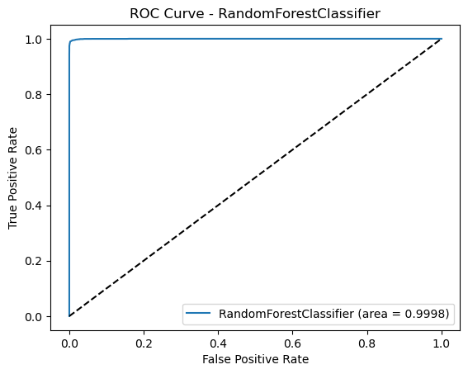
Random forest:
uses multiple decision trees to accurately predict which customers are likely to subscribe to a term deposit.
precision | recall | f1-score | support
0 - 1.00 | 0.91 | 0.97 | 7985
1 - 0.94 | 1.00 | 0.97 | 7984
accuracy
0.96
Accuracy = 97% → The model made correct predictions for 97 out of every 100 customers.
Precision
Class 0 (did not subscribe): 100% → All predicted "No" were actually correct.
Class 1 (subscribed): 94% → Most predicted "Yes" were truly "Yes".
Recall
Class 0: 94% → 94 out of every 100 actual "No" cases were identified correctly.
Class 1: 100% → All actual "Yes" cases were captured.
F1-Score
Both classes: 97% → Shows a perfect balance of precision and recall.

Slide 9

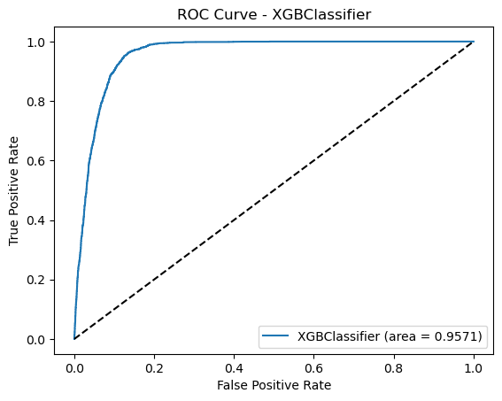
XGBoost :
provides state-of-the-art accuracy, handles imbalanced (if any) data well, and allows fine-tuned control over model complexity
precision | recall | f1-score | support
0 - 0.95 | 0.87 | 0.91 | 7985
1 -0.88 | 0.96 | 0.92 | 7984
accuracy
0.91
Accuracy = 91% → The model correctly predicted 91 out of 100 customer outcomes.
Precision
Class 0 (did not subscribe): 95% → Most predicted "No" were actually correct.
Class 1 (subscribed): 88% → Fairly good at predicting actual "Yes".
Recall
Class 0: 87% → 87 out of 100 real "No" cases identified correctly.
Class 1: 96% → Very good at identifying actual "Yes" cases.

Slide 10
Evaluation Matrix
Before training and developing a model, the data was balanced’
Reason – ‘No’ subscribers were more and the inclination was towards ‘No’ then ‘Yes’
Before balancing: y 0 39922 1 5289 Name: count, dtype: int64
After balancing: y 0 39922 1 39922 Name: count, dtype: int64
Model | Accuracy | Precision | Recall | F1 score | ROC - AUC
Logistic Regression | 0.809694 | 0.808330 | 0.811874 | 0.810098 | 0.884740
Decision Tree | 0.956353 | 0.920291 | 0.999248 | 0.958146 | 0.956356
Random Forest | 0.970505 | 0.944714 | 0.999499 | 0.971335 | 0.999779
Random Forest | 0.912894 | 0.878690 | 0.958041 | 0.916652 | 0.957112

Slide 11
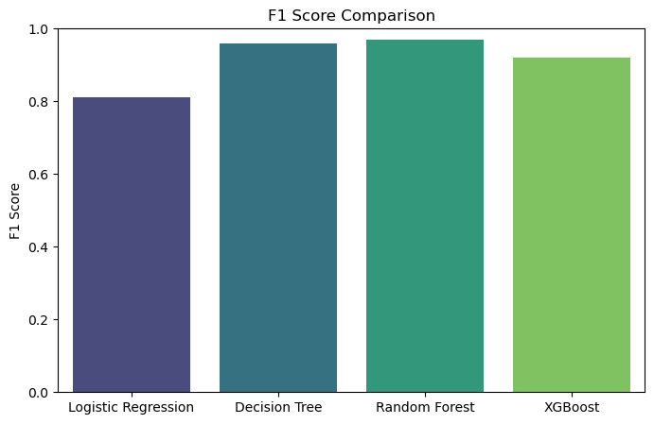
Evaluation Matrix
Random Forest is the best-performing model because it combines the power of multiple decision trees, capturing complex patterns in the data, which leads to the highest accuracy (97.1%), near-perfect recall (99.9%), and excellent overall balance—making it highly reliable for predicting customer subscriptions.

Slide 12
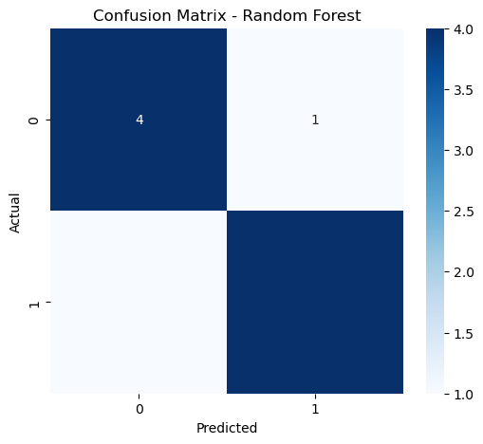
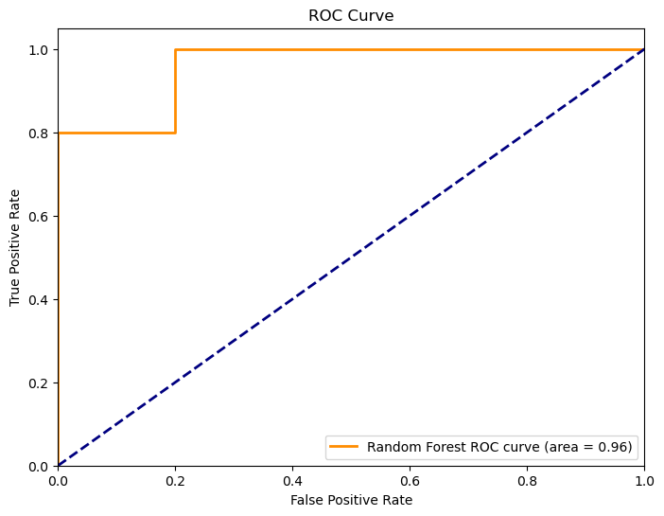
Insights to meet objectives
According to the Random Forest model, out of 15,969 customers, approximately 7,984 are predicted to subscribe to the term deposit, allowing the bank to precisely target nearly half of its customer base with high confidence.
Random Forest is a machine learning algorithm that combines many decision trees to make accurate predictions.
In our project, it predicts whether a customer is likely to subscribe to a term deposit.
Since it performed the best (97.1% accuracy), we recommend using this model to:
Analyze customer data
Identify high-potential customers
Target only those likely to say “Yes”
This approach helps:
Improve campaign success
Reduce marketing costs
Increase ROI (Return on Investment)

